Slide 1

Marketing on Steam
Presented by: Katelyn Carlini

Slide 2
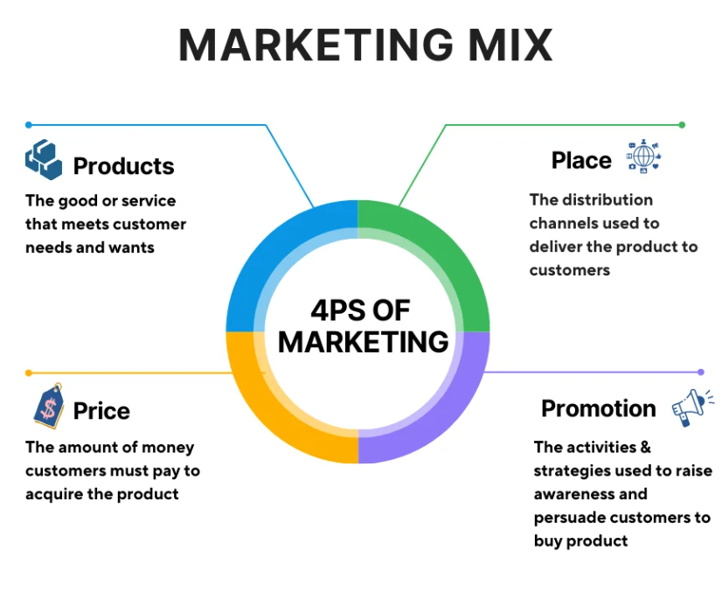
Purpose
The Digital Storefront, Steam is a massive market that is made up of over 100,000 games. As a consumer of games and of general interest I want to see what aspects contribute to a game's success on Steam. To accomplish this, I decided to look into the 4p’s of marketing
How It Applies To Game Development:
Product - Content and Genre
Place - Steam
Price - F2P to Expensive
Promotion - Player Engagement
Notes:
- Marketing is not just promotion, it begins with the product and involves price and place as well

Slide 3
Measures and Assumptions
High game ownership = Success. Game ownership is estimated. For analysis the average is used.
Place - An unsuccessful game does not equal a bad game.
Price - The typical price for the genre can act as a metric for how to market the game.
Product - Genres on Steam will have different characteristics and expectations.
Using a popular genre as a point of reference is a good way to compare how different genres perform.

Slide 4
3 Main Questions
What is the market climate of Steam?
Are there any aspects in particular that will make a large contribution to the success of a game?
How should the game be priced?
Does the accessibility of F2P outweigh potential losses in quality
Average price for top games, top genre, and preferred genre.
Genre Distribution & Popularity
How does the average game on Steam do regarding its playerbase?
Notes:
Limitations: no revenue column

Slide 5
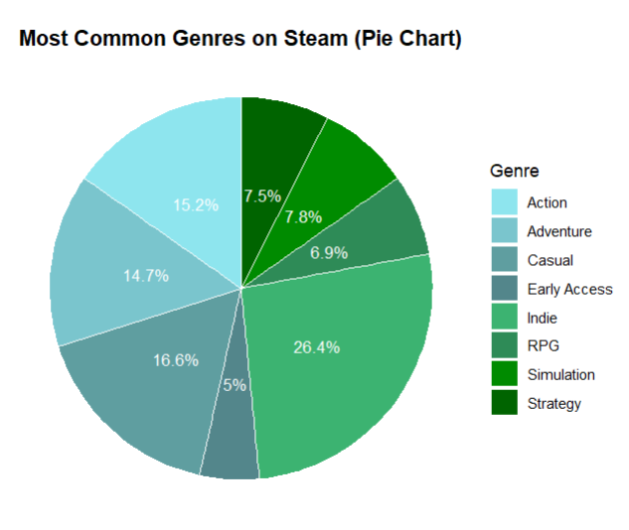
However, most popular = Action
Main Genres on Steam

Slide 6
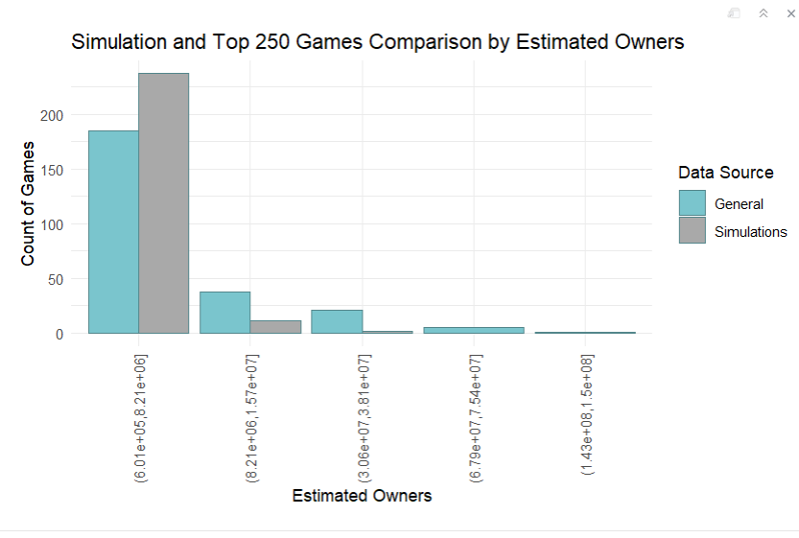
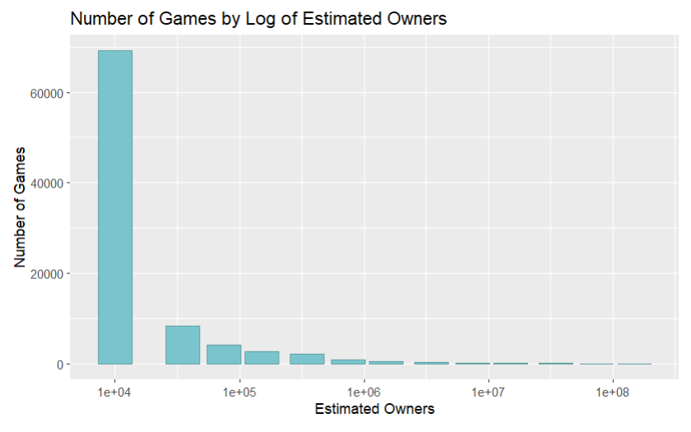
Steam’s Market Climate
Most games have ~ 1000 players

Slide 7
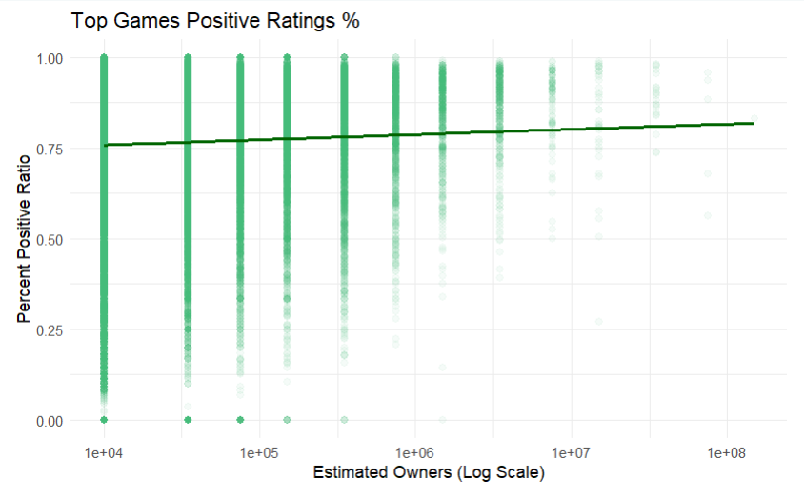
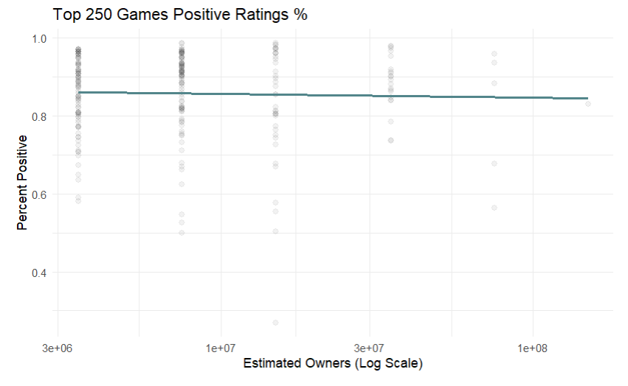
Player Engagement

Slide 8
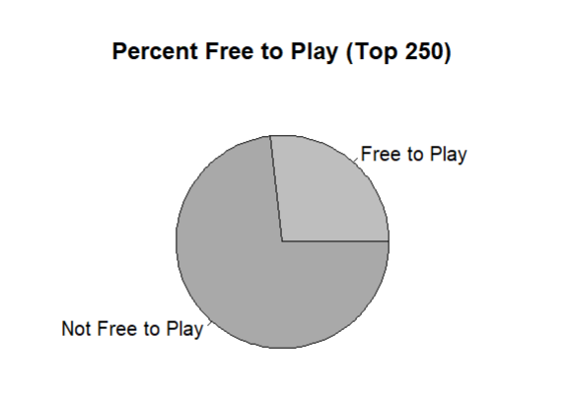
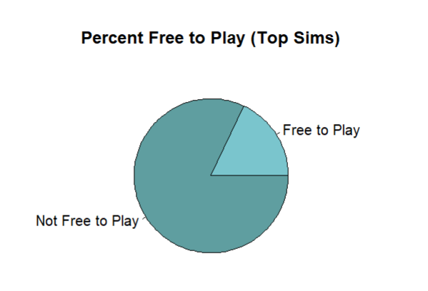
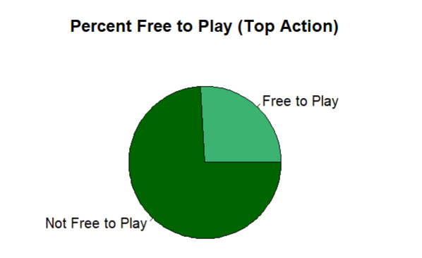
Accessibility Vs. Quality

Slide 9
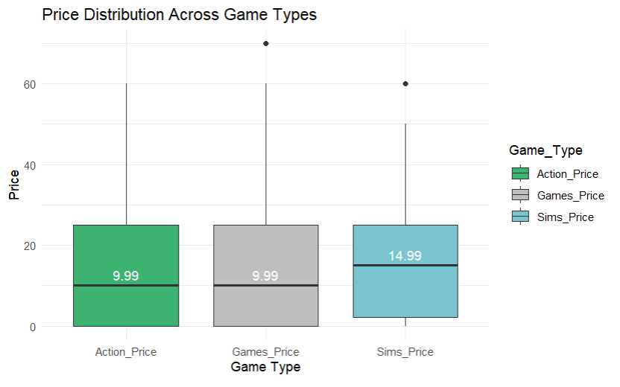
Price Difference Between Genres

Slide 10

Conclusions
Games in the Simulation Genre have the capacity to have a large player base.
Steam responds best to games in the action genre
Quality is more important than sheer affordability.
A Good starting price point for a Sim game is $14.99
Negative Ratings are inevitable but a good positive to negative ratio lies around 75%
Genres fill their own niches, and the game will make its way to its “intended audience.”
Summary: A Great Game is a Great Game
Notes:
Enjoyment is Subjective, success is up to the fates, and the best someone can do is get their game out there. Particularly when considering the aspect is mainly genre.

Slide 11

References
FronkonGames. "Steam Games Dataset." Kaggle, 24 Aug. 2023, www.kaggle.com/datasets/fronkongames/steam-games-dataset.
"Simulation video game." Wikipedia, 3 Nov. 2024, en.wikipedia.org/wiki/Simulation_video_game.
"Starfield (video game)." Wikipedia, 6 Nov. 2024, en.wikipedia.org/wiki/Starfield_(video_game).
"Steam Charts: Top 100." Steam, store.steampowered.com/charts/. Accessed 9 Nov. 2025.
"Store Home." Steam, store.steampowered.com/games. Accessed 9 Nov. 2025.
"Top questions." Stack Overflow, stackoverflow.com/questions. Accessed 9 Nov. 2025.
"Why Are Games So Expensive Now? Factors Driving Up Game Prices." DHgate Smart Blog, smart.dhgate.com/why-are-games-so-expensive-now-factors-driving-up-game-prices/. Accessed 9 Nov. 2025. Going Indie Biz. (2024, July 27). Steam marketing expert reveals algorithm secrets [Video]. YouTube. https://www.youtube.com/watch?v=CfSThW3GwvM
Summer. (2025, March 17). The Four PS of Marketing: Definition, Role, and Questions to consider - Mageplaza. The Most Feature-rich Extension Developer for Magento 2 - Adobe Commerce. https://www.mageplaza.com/blog/4-ps-of-marketing.html

